Slide 1
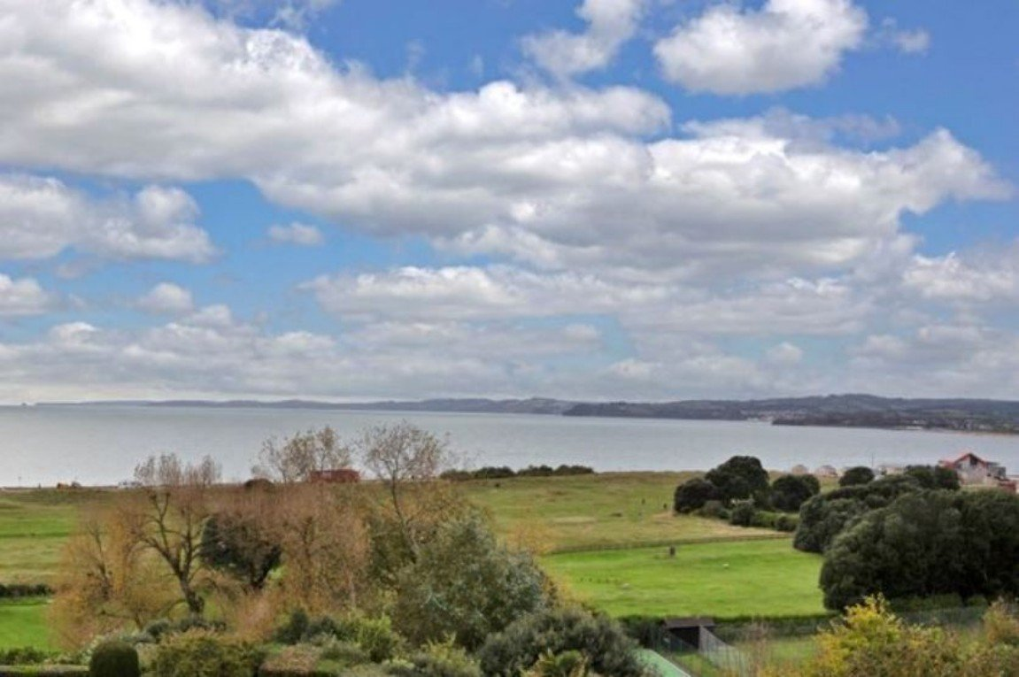
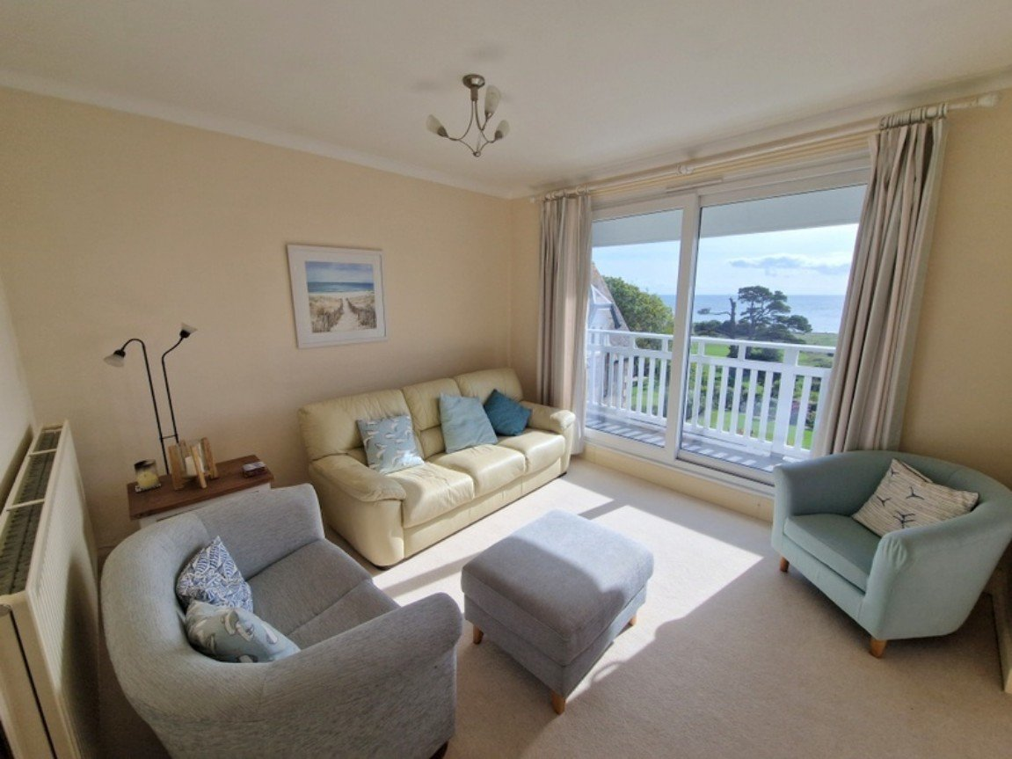
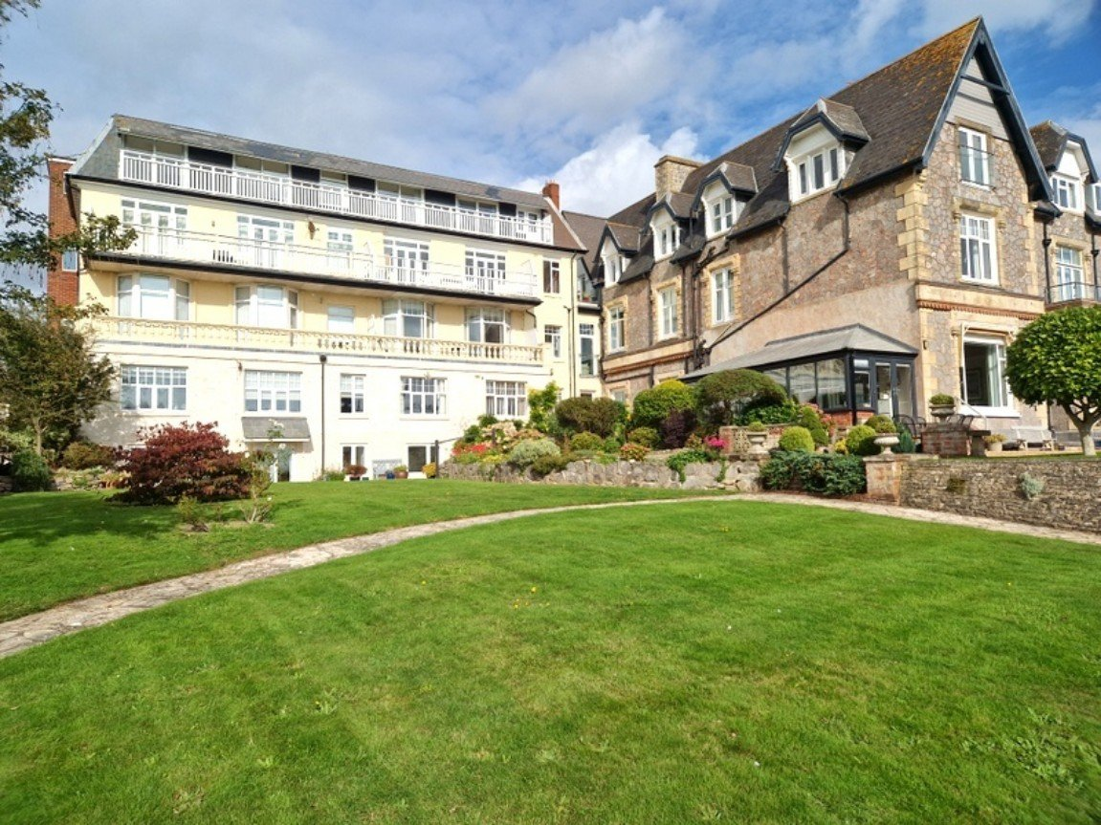
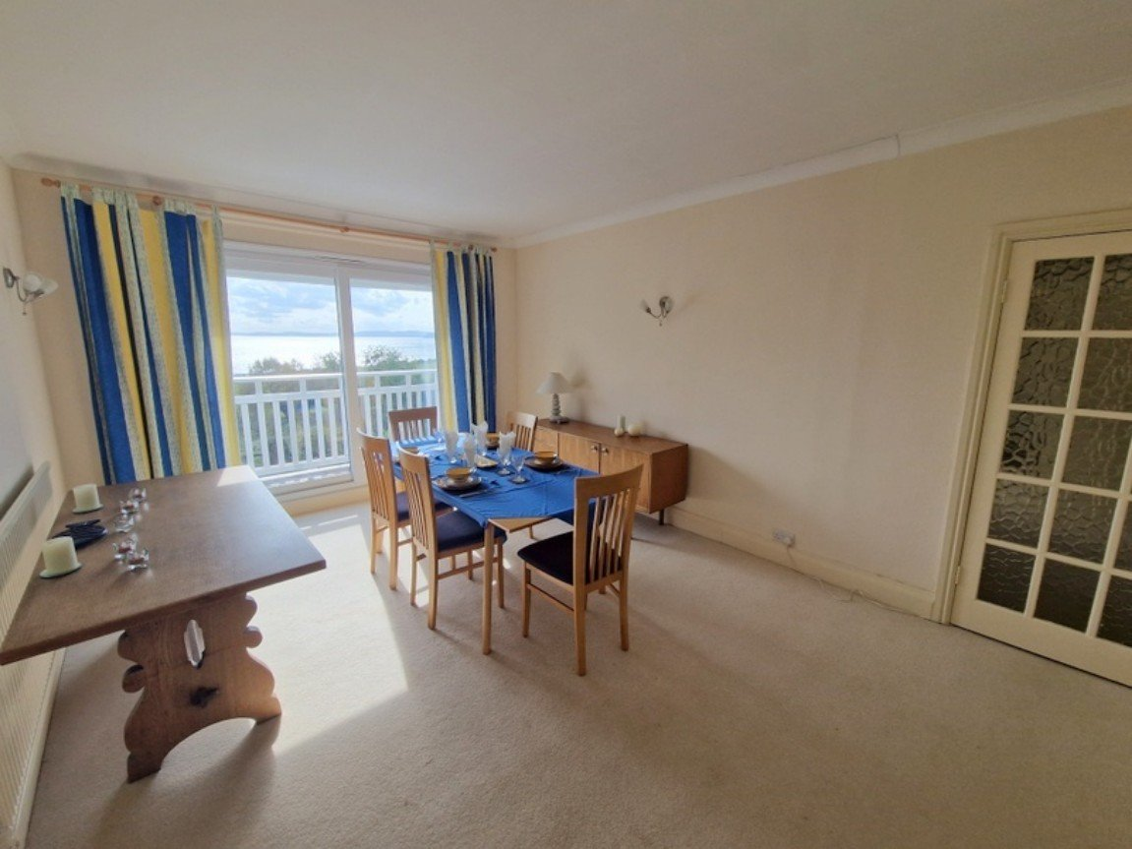
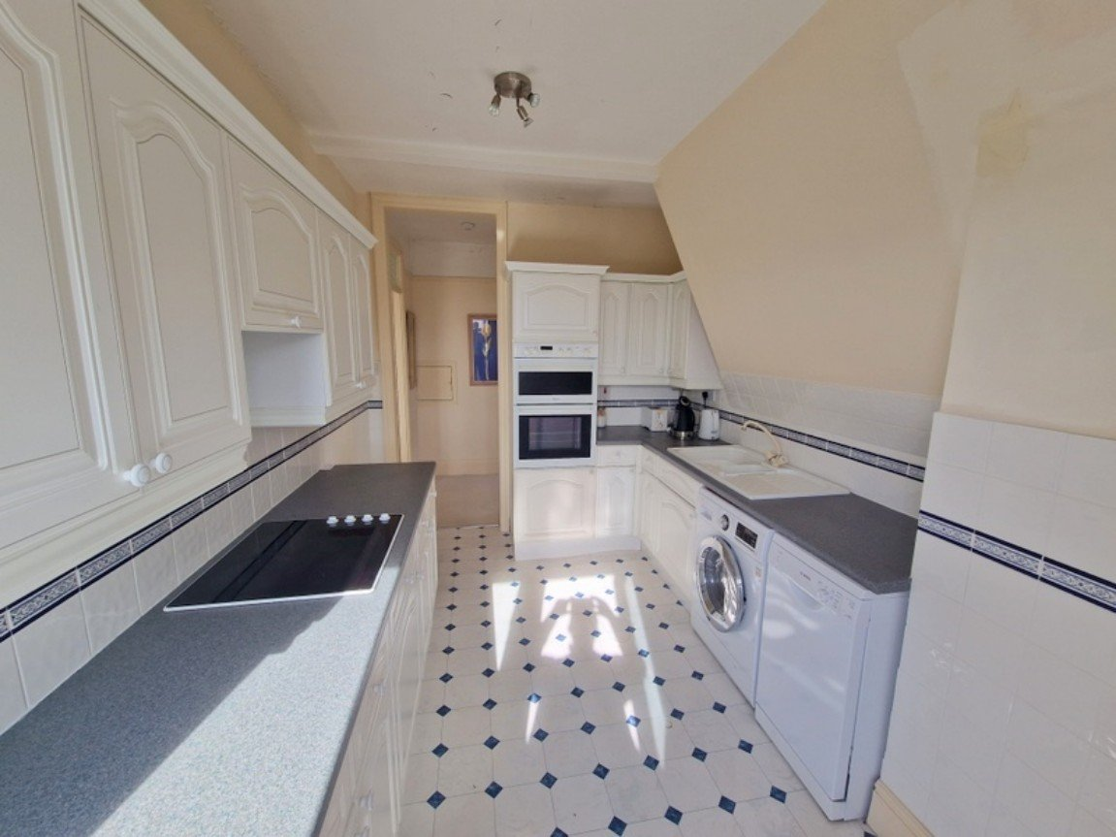
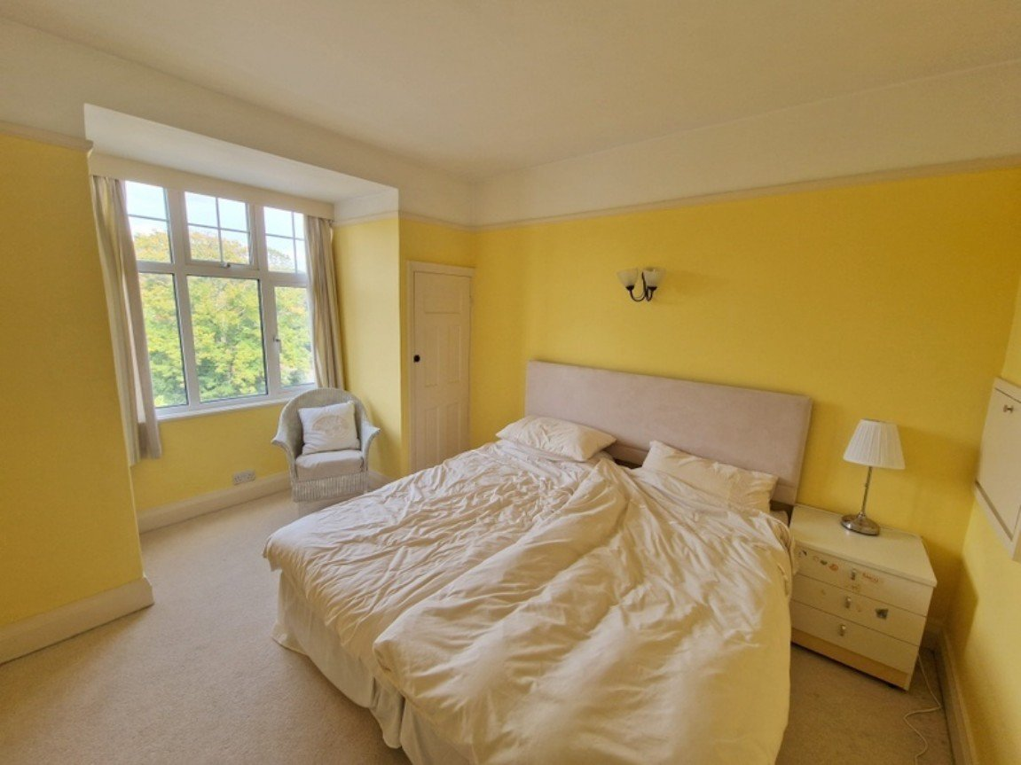
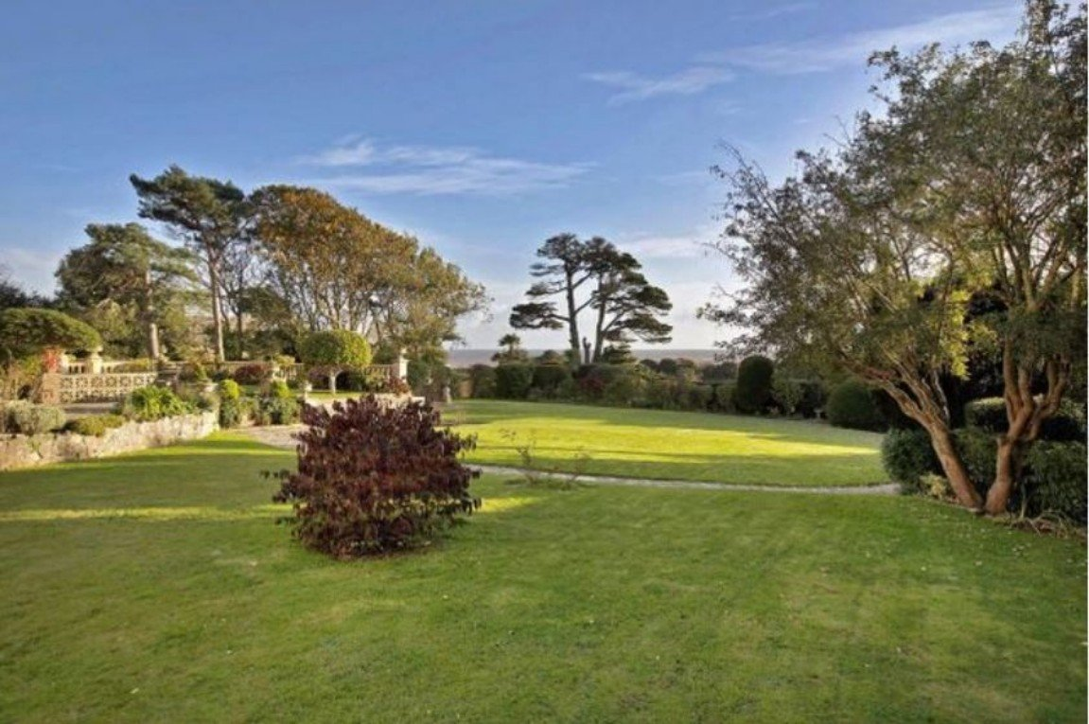
www.pennys.net
Flat 8 Maer Bay Court, 12 Douglas Avenue, Exmouth, EX8 2BX
GUIDE PRICE
475,000
TENURE Share of Freehold
A Wonderful Top Floor Apartment Enjoying The Most Sunning Coastline Views, Picturesque Communal Gardens And Garage
Lounge/Dining Room • Kitchen •
Three Bedrooms • Bathroom/WC •
Large Sun Balcony - Accessed From Lounge, Bedroom And Kitchen •
Gas Central Heating • Double Glazing •
NO ONWARD CHAIN •
EPC TO FOLLOW:
Pennys Estate Agents Limited for themselves and for the vendor of this property whose agents they are give notice that:- (1) These particulars do not constitute any part of an offer or a contract. (2) All statements contained in these particulars are made without responsibility on the part of Pennys Estate Agents Limited. (3) None of the statements contained in these particulars are to be relied upon as a statement or representation of fact. (4) Any intending purchaser must satisfy himself/herself by inspection or otherwise as to the correctness of each of the statements contained in these particulars. (5) The vendor does not make or give and neither do Pennys Estate Agents Limited nor any person in their employment has any authority to make or give any representation or warranty whatever in relation to this property.
PENNYS ESTATE AGENTS
2 Rolle House, Rolle Street, Exmouth, Devon, EX8 2SN
Tel: 01395 264111 EMail: help@pennys.net

Slide 2
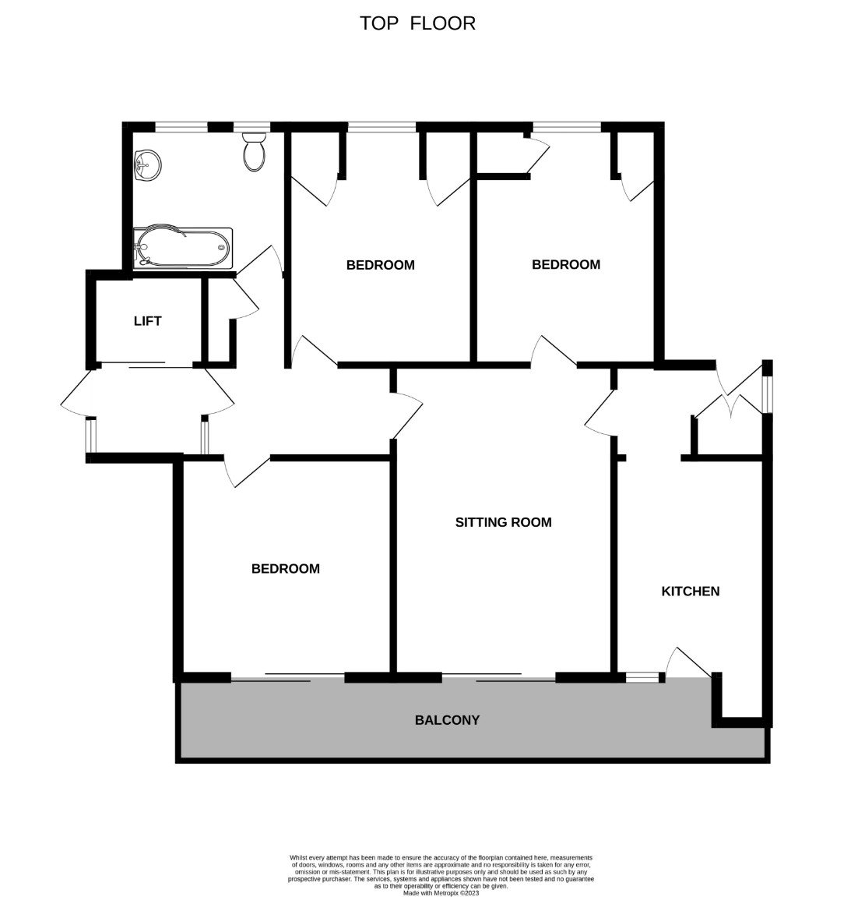
Flat 8 Maer Bay Court, 12 Douglas Avenue, Exmouth, EX8 2BX
A stunning penthouse style apartment in arguably one of Exmouth's finest locations with views of Exmouth beach, Exe estuary, Haldon Hills, Brixham to Berry Head and lighthouse. It also provides a 'birds eye' view of shipping, yachting, windsurfing races and firework displays. The beautiful residents' garden provides a variety of areas to enjoy and includes seating and a magnificent pond. It also offers direct access to Madeira Walk, providing a level walk into town and the Maer, Exmouth Beach and leisure area. THE ACCOMMODATION COMPRISES: Lift rising to the top floor to hallway; private front door to: RECEPTION HALL: Picture rail; electric consumer unit. LOUNGE/DINING ROOM: 5.18m x 3.66m (17'0" x 12'0") Sliding patio doors to BALCONY gaining stunning views over the Maer with uninterrupted sea and coastline views; two radiators; door to: INNER HALLWAY: Useful storage cupboards; double glazed window and private door giving separate staircase access to ground floor and outside. KITCHEN: 3.63m x 2.59m (11'11" x 8'6") Fitted with a range of work top surfaces; inset single drainer sink unit; cupboards and drawers; plumbing for an automatic washing machine and dishwasher beneath; built-in oven and ceramic hob set into work top; wall mounted cupboards; open cupboard housing fridge freezer; tiled surrounds; double glazed window over and door giving access to the BALCONY and gaining wonderful coastline views. BEDROOM ONE: 3.66m x 3.51m (12'0" x 11'6") Sliding patio door giving access to the balcony and gaining stunning coastline views; radiator. BEDROOM TWO: 4.17m x 3.07m (13'8" x 10'1") into dormer style. Double glazed window to front elevation; picture rail; radiator; two fitted cupboards. BEDROOM THREE: 4.17m x 3.02m (13'8" x 9'11") into dormer. Double glazed window; two fitted cupboards; radiator; picture rail. From reception hall opening to hallway with fitted cupboard and door to: BATHROOM/WC: 2.9m x 2.06m (9'6" x 6'9") A modern suite with whirl pool bath, shower over and shower screen; pedestal wash hand basin with tiled splash back and mirror with integrated light; chrome heated towel rail; WC with push button flush; two double glazed windows with frosted glass; tiled floor; underfloor heating; extractor fan; recessed ceiling spotlighting. OUTSIDE: Maer Bay Court has beautiful communal grounds all facing in a southerly direction with views towards Berry Head. The gardens are mainly laid to lawn with well kept flower beds and a large rectangular carp pond. There is also a gate in the communal gardens which leads to Madeira Walk. The GARAGE is in a block and measures 16'x10' with an up and over door, electric power point and a PARKING SPACE.
TENURE AND OUTGOINGS: The service charge is approximately £275.00 per calendar month per flat which includes a contribution towards the lift maintenance and also includes central heating, hot water, maintenance of boiler, cleaning, redecoration and maintenance of communal areas, gardening/landscaping and buildings insurance. The property also pays £500 twice a year into a general fund. The property benefits from a 999 year lease from 1961 and also 1/16th share of Maer Bay Freeholds (Exmouth LTD). AGENTS NOTE: The central heating is communal and the bathroom has underfloor heating and a towel rail which is independent from communal heating.
FLOOR PLAN:

